Slide 1
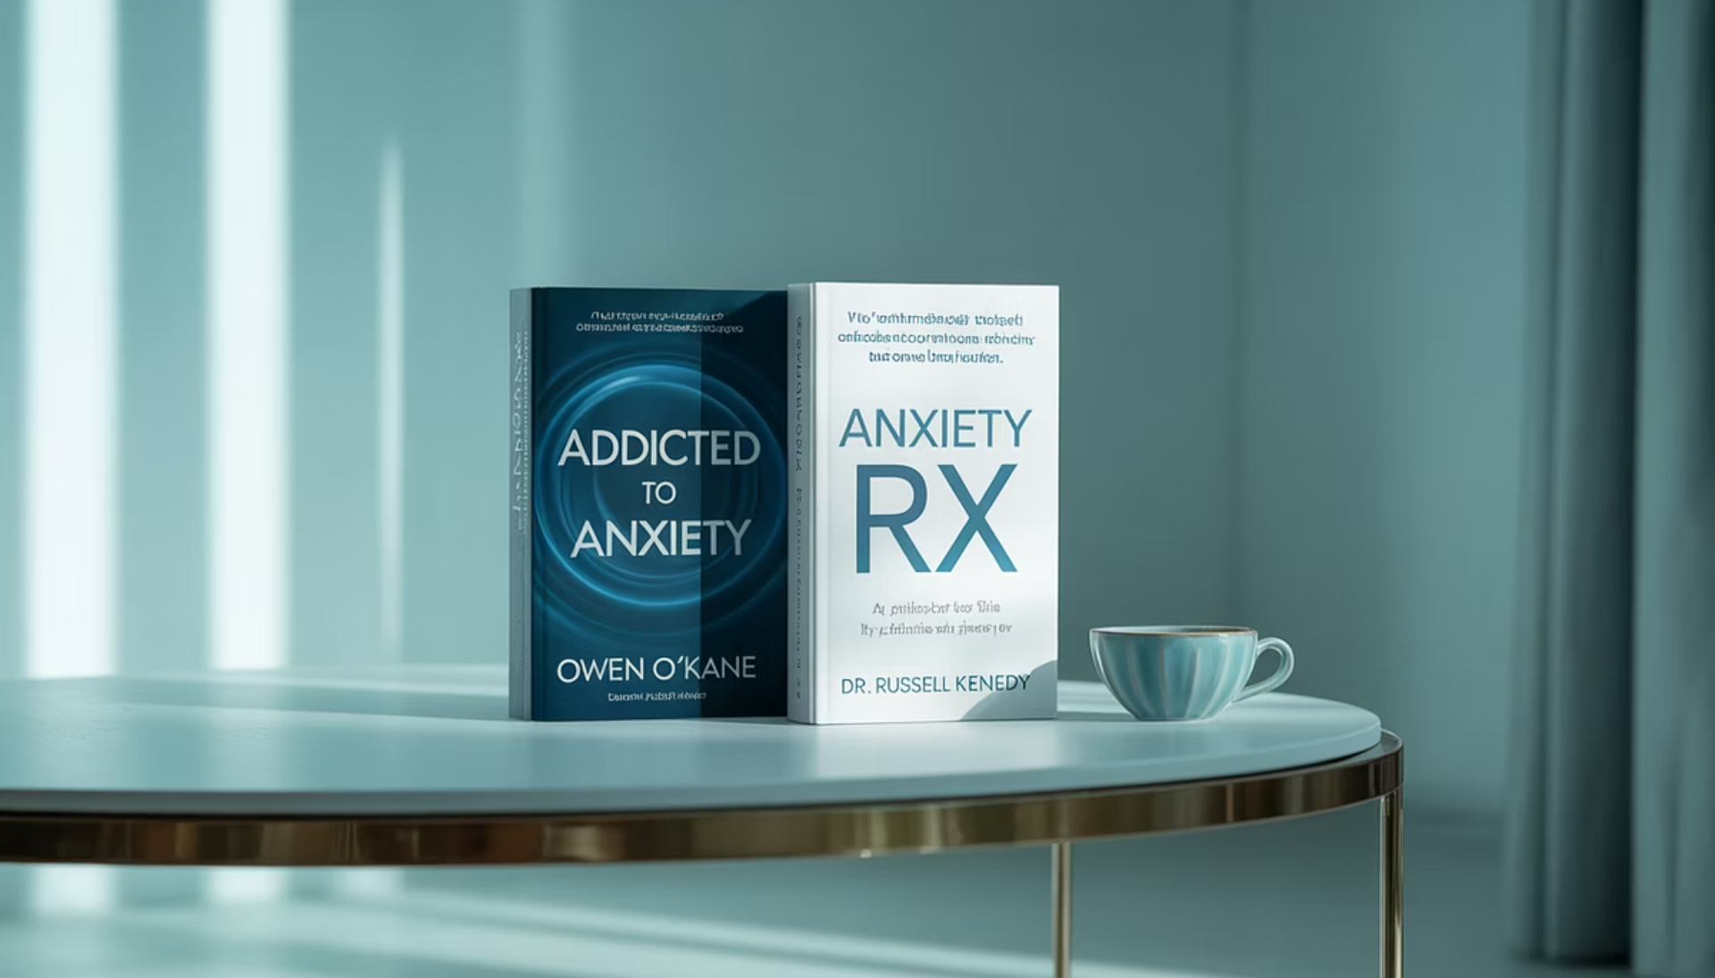
Are You Addicted to Anxiety... or Is Your Body Holding On to It?
Inspired by Owen O'Kane & Dr. Russell Kennedy
Swipe to understand anxiety differently →

Slide 2
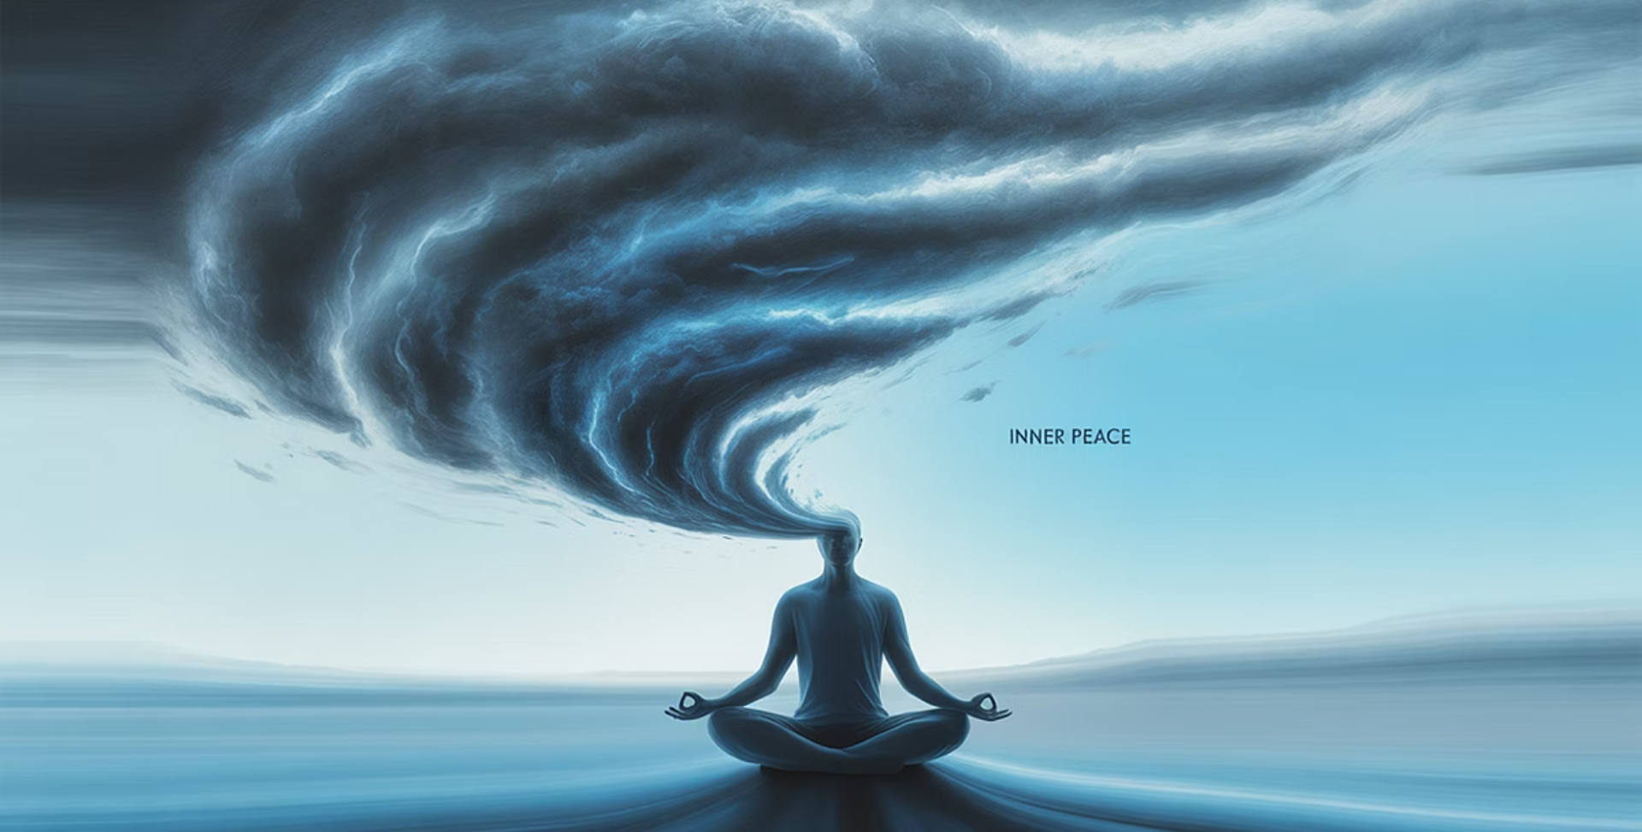
Anxiety Feels Overwhelming...
Addicted to Anxiety (Owen O'Kane)
Anxiety becomes a habit loop we unknowingly reinforce daily.
Anxiety Rx (Dr. Russell Kennedy)
Anxiety is emotional alarm signals trapped in your body.

Slide 3
Is Anxiety Your Go-To Habit?
Feel Anxious
Avoid/Control
Temporary Relief
Repeat
Break the loop through awareness and mindful action.

Slide 4
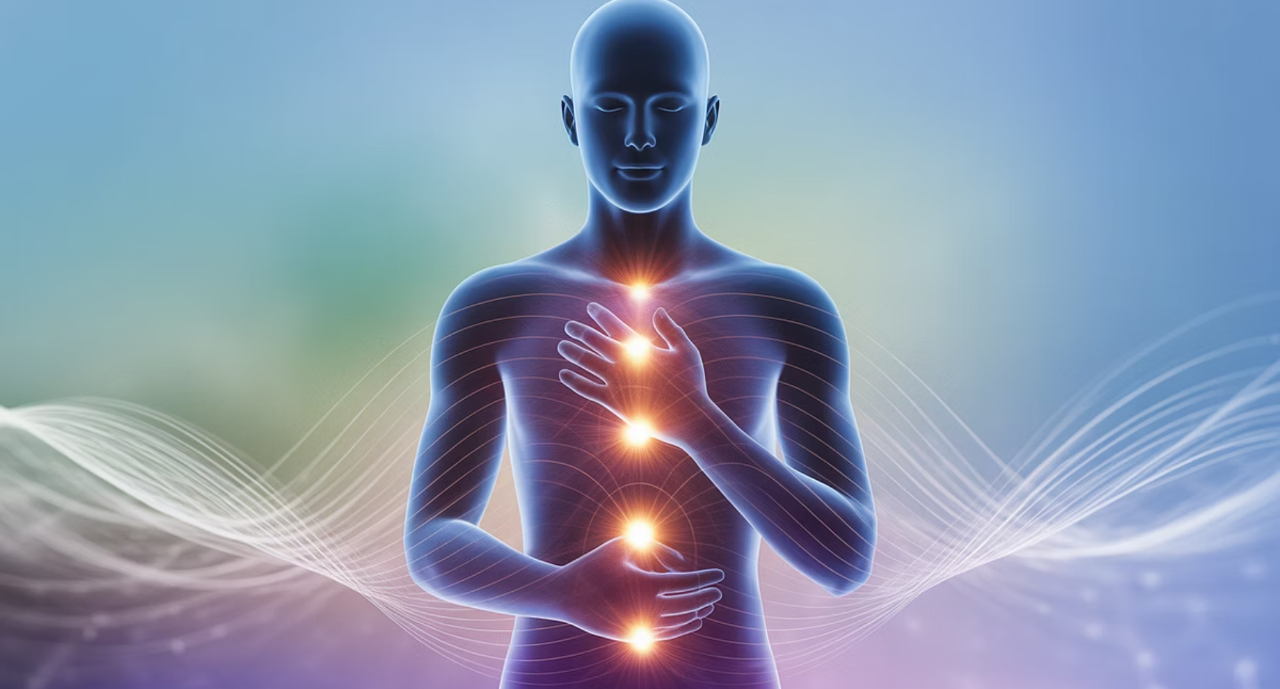
Is Anxiety Stored in Your Body?
Unresolved Trauma
Creates emotional alarms that stay trapped in your body.
Body Awareness
Healing happens by nurturing your inner child.

Slide 5
3 Ways to Ease Anxiety Today
Mind Approach
Body Approach
Break the loop with grounding
Body scan: Find your "alarm"
Reframe anxious thoughts
Comfort your inner child

Slide 6
You Don't Have to Choose—Use Both
Shift Your Thoughts
Challenge the habit loop.
Heal Your Body
Release stored emotional alarms.
You're not broken. Anxiety is a signal, not a flaw.

Slide 7
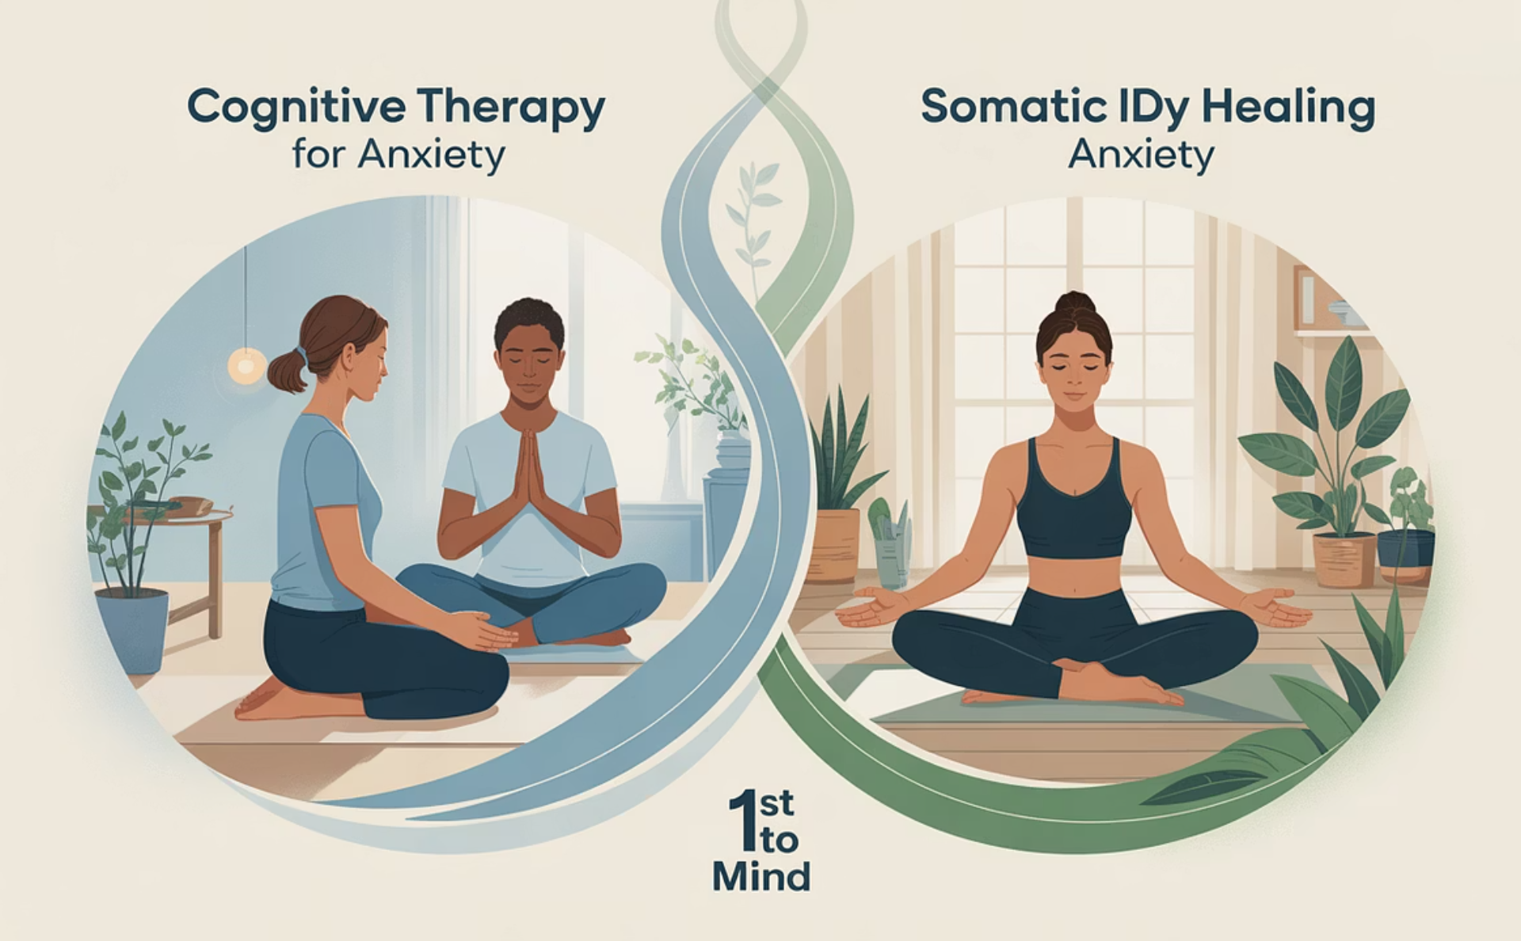
Ready to Explore a New Path with Anxiety?
Message me today and take your next step toward mental fitness.
#MentalFitness #AnxietyHealing #AddictedToAnxiety #AnxietyRx

Slide 8
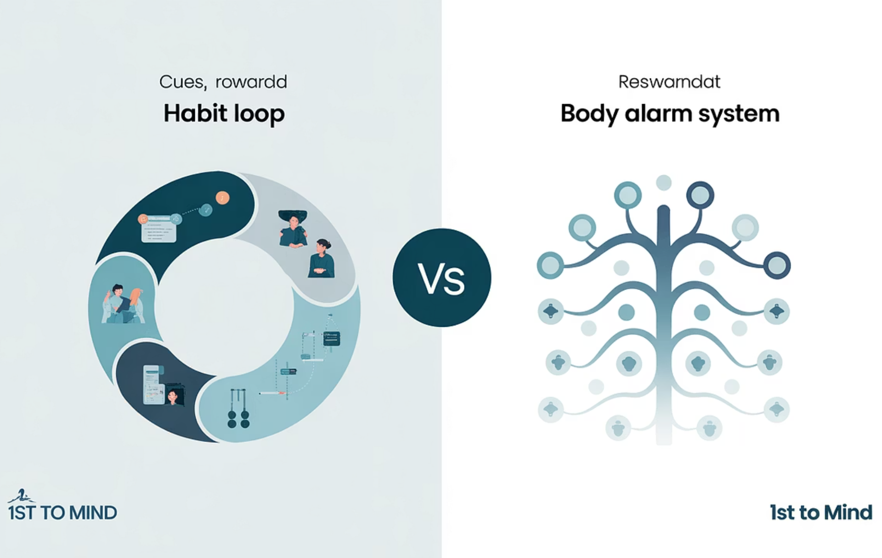
Which Approach Resonates With You?
Habit loop or body alarm? Comment below!
Tag someone who needs this perspective on anxiety.

